Slide 1
Unit 2

Slide 2
Understanding Requirements
Requirements are descriptions of the system's behavior, features, and constraints.
Understanding both functional and non-functional requirements is crucial in defining what the system should do and how it should perform.
The requirement engineering process—from feasibility studies to requirements management—ensures that the system being developed meets the needs of stakeholders and is feasible to implement. This process is iterative and involves continuous collaboration with stakeholders to refine and manage requirements throughout the project lifecycle.
Requirements are broadly categorized into two types:
Functional
Non-functional

Slide 3
Understanding Requirements
a) Functional Requirements:
Definition: Functional requirements describe what the system should do. They specify the functions that the system must perform, such as calculations, data processing, and business rules.
Examples:
The system shall allow users to log in with a username and password.
The application shall send an email confirmation upon user registration.
The system shall generate monthly financial reports.
b) Non-Functional Requirements:
Definition: Non-functional requirements describe how the system should perform its functions. They specify the quality attributes, such as performance, usability, reliability, and security.
Examples:
The system shall load the user dashboard within 2 seconds.
The application shall support 10,000 concurrent users.
The system shall ensure data encryption during transmission.

Slide 4
Requirement Engineering
Requirement engineering is a systematic approach to gathering, analyzing, and managing requirements. The process typically includes the following stages:
Feasibility Studies:
Purpose: The feasibility study evaluates whether the proposed system is viable and worth pursuing. It considers technical, economic, legal, and operational aspects.
Key Activities:
Technical Feasibility: Assessing whether the technology needed to implement the system exists and is mature enough.
Economic Feasibility: Estimating costs and benefits to determine if the project is financially viable.
Legal Feasibility: Ensuring that the system complies with legal and regulatory requirements.
Operational Feasibility: Analyzing whether the system can be integrated into existing operations and whether it will be accepted by users.

Slide 5
Requirement Engineering
b) Requirements Elicitation and Analysis:
Purpose: Gathering and understanding the needs and expectations of stakeholders.
Key Techniques:
Interviews: Conducting interviews with stakeholders to gather their requirements.
Surveys/Questionnaires: Distributing surveys to gather a broad range of opinions.
Workshops: Organizing workshops to collaborate with stakeholders in defining requirements.
Observation: Observing how users currently perform tasks to identify needs.
Prototyping: Creating prototypes to visualize and refine requirements.
Analysis: After gathering requirements, they need to be analyzed for consistency, completeness, and feasibility.

Slide 6
Requirement Engineering
c) Requirements Validation:
Purpose: Ensuring that the gathered requirements accurately reflect the needs of stakeholders and are achievable.
Key Activities:
Review: Stakeholders review the requirements document to confirm accuracy.
Prototyping: Validating requirements through prototypes to ensure they meet user needs.
Modeling: Creating models (e.g., data flow diagrams) to validate requirements.
Test Cases: Developing test cases to ensure that the requirements can be tested during the implementation phase.

Slide 7
Requirement Engineering
d) Requirements Management:
Purpose: Requirement Management is an ongoing process in the software development life cycle that ensures all project requirements are properly tracked, controlled, and fulfilled throughout the development process.
Key Activities:
Version Control: Keeping track of different versions of the requirements document.
Change Control: Managing changes to requirements in a controlled manner to avoid scope creep.
Traceability: Establishing relationships between requirements and other project artifacts (e.g., design documents, test cases) to ensure that all requirements are met.
Prioritization: Prioritizing requirements based on their importance and impact on the project.

Slide 8
The Problems with our Requirements Practices
We have trouble understanding the requirements that we do acquire from the customer
We often record requirements in a disorganized manner
We spend far too little time verifying what we do record
We allow change to control us, rather than establishing mechanisms to control change
Most importantly, we fail to establish a solid foundation for the system or software that the user wants built

Slide 9
The Problems with our Requirements Practices (continued)
Many software developers argue that
Building software is so compelling that we want to jump right in (before having a clear understanding of what is needed)
Things will become clear as we build the software
Project stakeholders will be able to better understand what they need only after examining early iterations of the software
Things change so rapidly that requirements engineering is a waste of time
The bottom line is producing a working program and that all else is secondary
All of these arguments contain some truth, especially for small projects that take less than one month to complete
However, as software grows in size and complexity, these arguments begin to break down and can lead to a failed software project

Slide 10
A Solution: Requirements Engineering
Begins during the communication activity and continues into the modeling activity
Builds a bridge from the system requirements into software design and construction
Allows the requirements engineer to examine
the context of the software work to be performed
the specific needs that design and construction must address
the priorities that guide the order in which work is to be completed
the information, function, and behavior that will have a profound impact on the resultant design

Slide 11
Requirements Engineering Tasks
Seven distinct tasks
Inception
Elicitation
Elaboration
Negotiation
Specification
Validation
Requirements Management
Some of these tasks may occur in parallel and all are adapted to the needs of the project
All strive to define what the customer wants
All serve to establish a solid foundation for the design and construction of the software

Slide 12
Example Project: Campus Information Access Kiosk
Both podium-high and desk-high terminals located throughout the campus in all classroom buildings, admin buildings, labs, and dormitories
Hand/Palm-login and logout (seamlessly)
Voice input
Optional audio/visual or just visual output
Immediate access to all campus information plus
E-mail
Cell phone voice messaging

Slide 13
Inception
Elicitation
Elaboration
Negotiation
Specification
Validation
Requirements
Management

Slide 14
Inception Task
During inception, the requirements engineer asks a set of questions to establish…
A basic understanding of the problem
The people who want a solution
The nature of the solution that is desired
The effectiveness of preliminary communication and collaboration between the customer and the developer
Through these questions, the requirements engineer needs to…
Identify the stakeholders
Recognize multiple viewpoints
Work toward collaboration
Break the ice and initiate the communication

Slide 15
The First Set of Questions
These questions focus on the customer, other stakeholders, the overall goals, and the benefits
Who is behind the request for this work?
Who will use the solution?
What will be the economic benefit of a successful solution?
Is there another source for the solution that you need?

Slide 16
The Next Set of Questions
These questions enable the requirements engineer to gain a better understanding of the problem and allow the customer to voice his or her perceptions about a solution
How would you characterize "good" output that would be generated by a successful solution?
What problem(s) will this solution address?
Can you show me (or describe) the business environment in which the solution will be used?
Will special performance issues or constraints affect the way the solution is approached?

Slide 17
The Final Set of Questions
These questions focus on the effectiveness of the communication activity itself
Are you the right person to answer these questions? Are your answers "official"?
Are my questions relevant to the problem that you have?
Am I asking too many questions?
Can anyone else provide additional information?
Should I be asking you anything else?

Slide 18
Inception
Elicitation
Elaboration
Negotiation
Specification
Validation
Requirements
Management

Slide 19
Elicitation Task
Eliciting requirements is difficult because of
Problems of scope in identifying the boundaries of the system or specifying too much technical detail rather than overall system objectives
Problems of understanding what is wanted, what the problem domain is, and what the computing environment can handle (Information that is believed to be "obvious" is often omitted)
Problems of volatility because the requirements change over time
Elicitation may be accomplished through two activities
Collaborative requirements gathering
Quality function deployment

Slide 20
Basic Guidelines of Collaborative Requirements Gathering
Meetings are conducted and attended by both software engineers, customers, and other interested stakeholders
Rules for preparation and participation are established
An agenda is suggested that is formal enough to cover all important points but informal enough to encourage the free flow of ideas
A "facilitator" (customer, developer, or outsider) controls the meeting
A "definition mechanism" is used such as work sheets, flip charts, wall stickers, electronic bulletin board, chat room, or some other virtual forum
The goal is to identify the problem, propose elements of the solution, negotiate different approaches, and specify a preliminary set of solution requirements

Slide 21
Quality Function Deployment
This is a technique that translates the needs of the customer into technical requirements for software
It emphasizes an understanding of what is valuable to the customer and then deploys these values throughout the engineering process through functions, information, and tasks
It identifies three types of requirements
Normal requirements: These requirements are the objectives and goals stated for a product or system during meetings with the customer
Expected requirements: These requirements are implicit to the product or system and may be so fundamental that the customer does not explicitly state them
Exciting requirements: These requirements are for features that go beyond the customer's expectations and prove to be very satisfying when present

Slide 22
Elicitation Work Products
The work products will vary depending on the system, but should include one or more of the following items
A statement of need and feasibility
A bounded statement of scope for the system or product
A list of customers, users, and other stakeholders who participated in requirements elicitation
A description of the system's technical environment
A list of requirements (organized by function) and the domain constraints that apply to each
A set of preliminary usage scenarios (in the form of use cases) that provide insight into the use of the system or product under different operating conditions
Any prototypes developed to better define requirements

Slide 23
Inception
Elicitation
Elaboration
Negotiation
Specification
Validation
Requirements
Management

Slide 24
Elaboration Task
During elaboration, the software engineer takes the information obtained during inception and elicitation and begins to expand and refine it
Elaboration focuses on developing a refined technical model of software functions, features, and constraints
It is an analysis modeling task
Use cases are developed
Domain classes are identified along with their attributes and relationships
State machine diagrams are used to capture the life on an object
The end result is an analysis model that defines the functional, informational, and behavioral domains of the problem

Slide 25
Developing Use Cases
Step One – Define the set of actors that will be involved in the story
Actors are people, devices, or other systems that use the system or product within the context of the function and behavior that is to be described
Actors are anything that communicate with the system or product and that are external to the system itself
Step Two – Develop use cases, where each one answers a set of questions

Slide 26
Questions Commonly Answered by a Use Case
Who is the primary actor(s), the secondary actor(s)?
What are the actor’s goals?
What preconditions should exist before the scenario begins?
What main tasks or functions are performed by the actor?
What exceptions might be considered as the scenario is described?
What variations in the actor’s interaction are possible?
What system information will the actor acquire, produce, or change?
Will the actor have to inform the system about changes in the external environment?
What information does the actor desire from the system?
Does the actor wish to be informed about unexpected changes?

Slide 27
Elements of the Analysis Model
Scenario-based elements
Describe the system from the user's point of view using scenarios that are depicted in use cases and activity diagrams
Class-based elements
Identify the domain classes for the objects manipulated by the actors, the attributes of these classes, and how they interact with one another; they utilize class diagrams to do this
Behavioral elements
Use state diagrams to represent the state of the system, the events that cause the system to change state, and the actions that are taken as a result of a particular event; can also be applied to each class in the system
Flow-oriented elements
Use data flow diagrams to show the input data that comes into a system, what functions are applied to that data to do transformations, and what resulting output data are produced

Slide 28
Inception
Elicitation
Elaboration
Negotiation
Specification
Validation
Requirements
Management

Slide 29
Negotiation Task
During negotiation, the software engineer reconciles the conflicts between what the customer wants and what can be achieved given limited business resources
Requirements are ranked (i.e., prioritized) by the customers, users, and other stakeholders
Risks associated with each requirement are identified and analyzed
Rough guesses of development effort are made and used to assess the impact of each requirement on project cost and delivery time
Using an iterative approach, requirements are eliminated, combined and/or modified so that each party achieves some measure of satisfaction

Slide 30
The Art of Negotiation
Recognize that it is not competition
Map out a strategy
Listen actively
Focus on the other party’s interests
Don’t let it get personal
Be creative
Be ready to commit

Slide 31
Inception
Elicitation
Elaboration
Negotiation
Specification
Validation
Requirements
Management

Slide 32
Specification Task
A specification is the final work product produced by the requirements engineer
It is normally in the form of a software requirements specification
It serves as the foundation for subsequent software engineering activities
It describes the function and performance of a computer-based system and the constraints that will govern its development
It formalizes the informational, functional, and behavioral requirements of the proposed software in both a graphical and textual format

Slide 33
Typical Contents of a Software Requirements Specification
Requirements
Required states and modes
Software requirements grouped by capabilities (i.e., functions, objects)
Software external interface requirements
Software internal interface requirements
Software internal data requirements
Other software requirements (safety, security, privacy, environment, hardware, software, communications, quality, personnel, training, logistics, etc.)
Design and implementation constraints
Qualification provisions to ensure each requirement has been met
Demonstration, test, analysis, inspection, etc.
Requirements traceability
Trace back to the system or subsystem where each requirement applies

Slide 34
Inception
Elicitation
Elaboration
Negotiation
Specification
Validation
Requirements
Management

Slide 35
Validation Task
During validation, the work products produced as a result of requirements engineering are assessed for quality
The specification is examined to ensure that
all software requirements have been stated unambiguously
inconsistencies, omissions, and errors have been detected and corrected
the work products conform to the standards established for the process, the project, and the product
The formal technical review serves as the primary requirements validation mechanism
Members include software engineers, customers, users, and other stakeholders

Slide 36
Questions to ask when Validating Requirements
Is each requirement consistent with the overall objective for the system/product?
Have all requirements been specified at the proper level of abstraction? That is, do some requirements provide a level of technical detail that is inappropriate at this stage?
Is the requirement really necessary or does it represent an add-on feature that may not be essential to the objective of the system?
Is each requirement bounded and unambiguous?
Does each requirement have attribution? That is, is a source (generally, a specific individual) noted for each requirement?
(more on next slide)

Slide 37
Questions to ask when Validating Requirements (continued)
Do any requirements conflict with other requirements?
Is each requirement achievable in the technical environment that will house the system or product?
Is each requirement testable, once implemented?
Approaches: Demonstration, actual test, analysis, or inspection
Does the requirements model properly reflect the information, function, and behavior of the system to be built?
Has the requirements model been “partitioned” in a way that exposes progressively more detailed information about the system?

Slide 38
Inception
Elicitation
Elaboration
Negotiation
Specification
Validation
Requirements
Management

Slide 39
Requirements Management Task
During requirements management, the project team performs a set of activities to identify, control, and track requirements and changes to the requirements at any time as the project proceeds
Each requirement is assigned a unique identifier
The requirements are then placed into one or more traceability tables
These tables may be stored in a database that relate features, sources, dependencies, subsystems, and interfaces to the requirements
A requirements traceability table is also placed at the end of the software requirements specification

Slide 40
Modelling Requirements
Modeling requirements is a crucial step in the software development process, where abstract requirements are transformed into visual representations. This helps stakeholders understand, validate, and refine the system's design.
1. Data Flow Diagram (DFD):
A Data Flow Diagram (DFD) is a graphical representation of the flow of data within a system. It shows how data is processed by the system in terms of inputs and outputs.
Components:
Processes: Represented by circles or ovals, they depict activities that transform inputs into outputs.
Data Stores: Represented by open-ended rectangles, they show where data is stored.
Data Flows: Represented by arrows, they illustrate the movement of data between processes, data stores, and external entities.
External Entities: Represented by rectangles, these are outside the system but interact with it (e.g., users, external systems).

Slide 41
Modelling Requirements
Consider a library management system. A simple DFD might include:
Processes: "Issue Book," "Return Book"
Data Stores: "Book Inventory," "Member Records"
External Entities: "Librarian," "Member"
Data Flows: "Book Request" flows from Member to Issue Book process; "Book Details" flows from Book Inventory to Issue Book process.

Slide 42
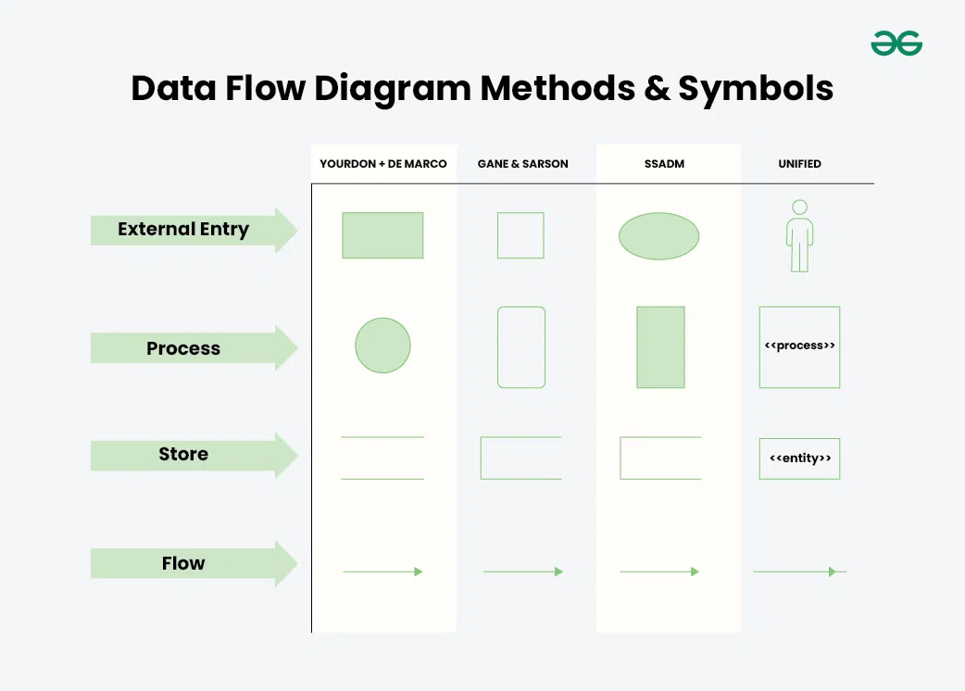
Modelling Requirements

Slide 43
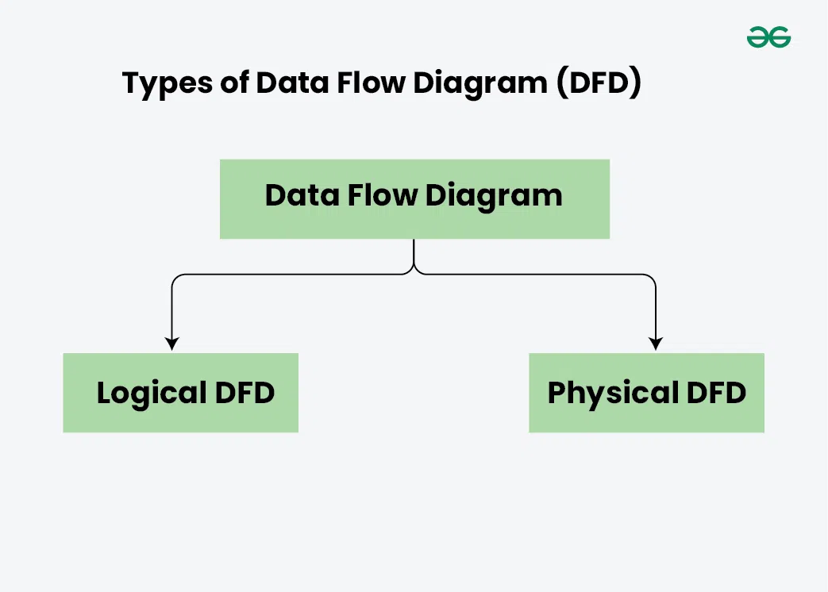
Modelling Requirements

Slide 44
Logical Data Flow Diagram (DFD)
The Logical Data Flow Diagram mainly focuses on the system process. It illustrates how data flows in the system. Logical Data Flow Diagram (DFD) mainly focuses on high level processes and data flow without diving deep into technical implementation details.
Logical DFDs is used in various organizations for the smooth running of system. Like in a Banking software system, it is used to describe how data is moved from one entity to another.

Slide 45
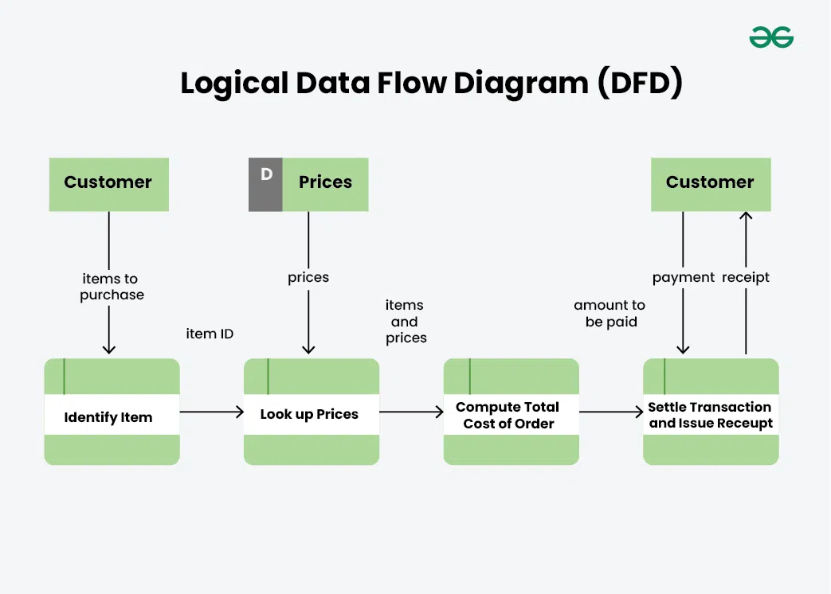

Slide 46
Physical Data Flow Diagram
Physical data flow diagram shows how the data flow is actually implemented in the system.
In the Physical Data Flow Diagram (DFD), we include additional details such as data storage, data transmission, and specific technology or system components.
Physical DFDs are more detailed and provide a closer look at the actual implementation of the system, including the hardware, software, and physical aspects of data processing.

Slide 47
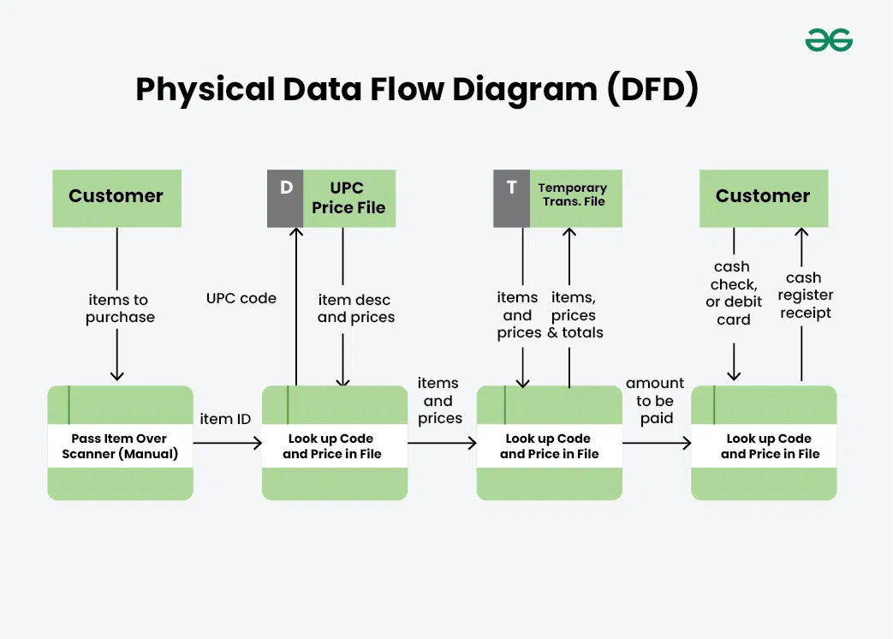
Physical Data Flow Diagram
.

Slide 48
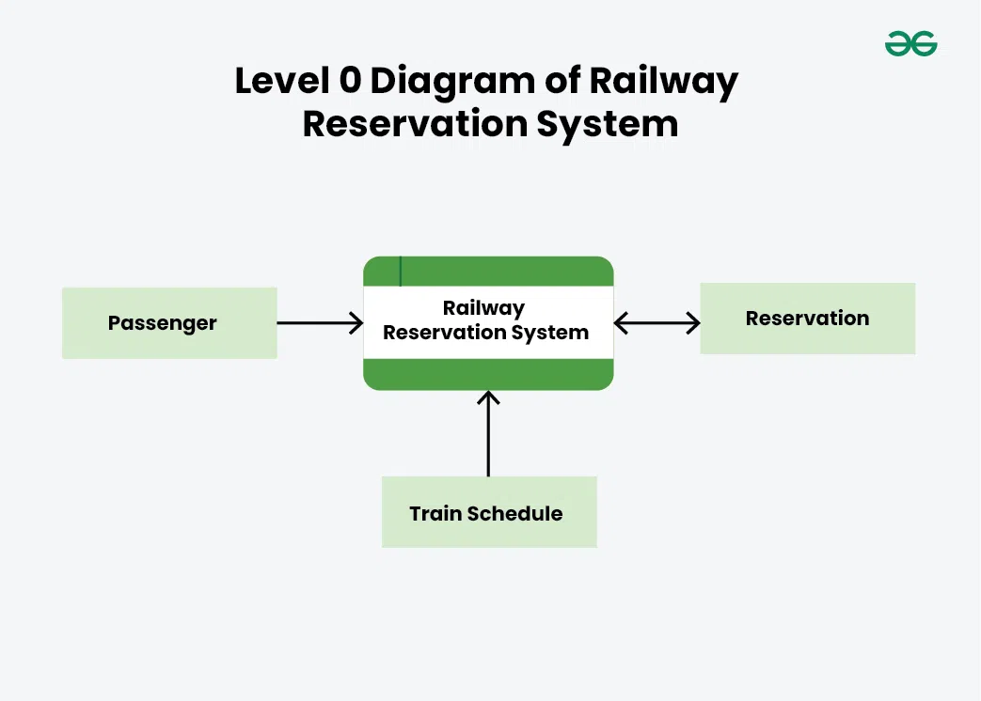

Slide 49
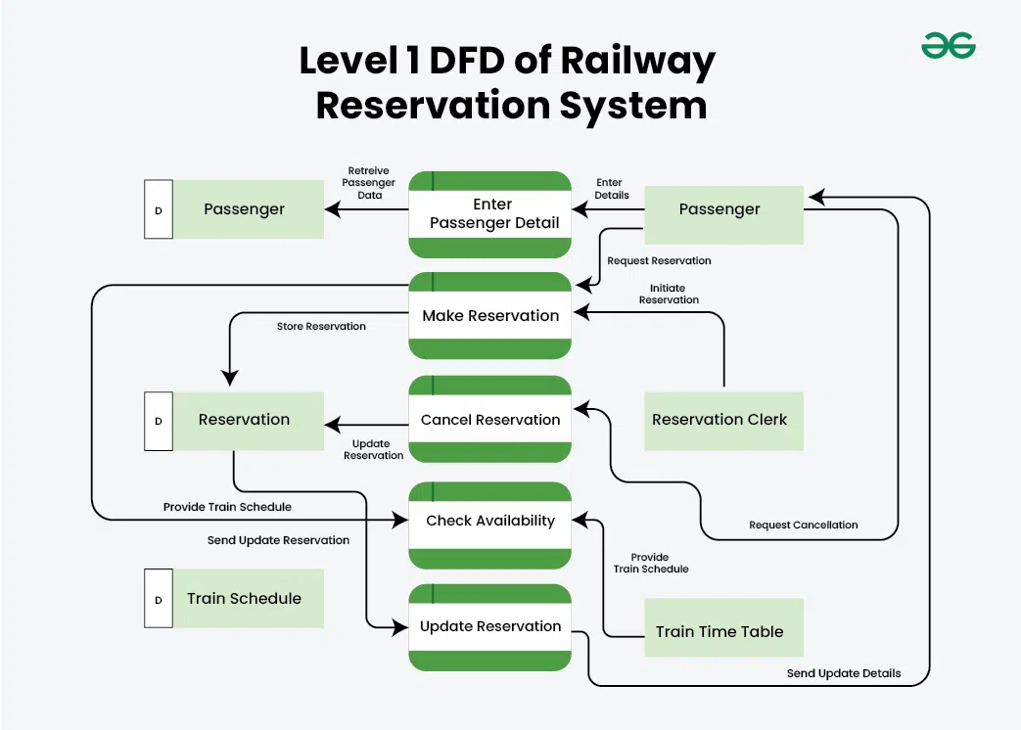

Slide 50
Modelling Requirements
2. Entity-Relation Diagram (ERD):
An Entity-Relation Diagram (ERD) is a visual representation of the data structure, showing entities (objects) and the relationships between them.
Components:
Entities: Represented by rectangles, these are objects or concepts within the system (e.g., "Student," "Course").
Attributes: Represented by ovals, these describe properties of entities (e.g., "Student ID," "Course Name").
Relationships: Represented by diamonds or labeled lines, these show how entities are related (e.g., "Enrolls" relationship between Student and Course).
Primary Key: An attribute that uniquely identifies an entity.
Foreign Key: An attribute in one entity that links to the primary key of another entity.

Slide 51
Modelling Requirements
Example:
In a university database:
Entities: "Student," "Course," "Instructor"
Relationships: "Enrolls" between Student and Course, "Teaches" between Instructor and Course
Attributes: "Student ID," "Student Name" for Student; "Course ID," "Course Name" for Course.
ERDs are used to design the database structure and ensure that all relationships between data entities are accurately represented.

Slide 52
Modelling Requirements
3. Data Dictionary:
A Data Dictionary is a detailed description of the data elements within the system. It acts as a reference that defines each data element's meaning, data type, format, allowable values, and relationships with other data elements.
Components:
Data Element Name: The name of the data field (e.g., "Student ID").
Description: A brief explanation of what the data element represents.
Data Type: The type of data (e.g., integer, string, date).
Format: The format of the data (e.g., "MM/DD/YYYY" for dates).
Allowed Values: The range or list of permissible values (e.g., "Male, Female, Other" for gender).
Default Value: The default value if none is provided.
Relationships: How this data element relates to others.

Slide 53
Modelling Requirements
For a "Student ID":
Data Element Name: Student ID
Description: A unique identifier for each student.
Data Type: Integer
Format: 7-digit number
Allowed Values: 1000000 to 9999999
The Data Dictionary ensures consistency in data use and helps developers understand how to handle each data element.

Slide 54
Example
An online bookstore allows users to browse, search, and purchase books. Users must register and log in to place an order. The system stores information about books, customers, orders, and payments.

Slide 55
Modelling Requirements
4. State Transition Diagram:
A State Transition Diagram (STD) models the states a system can be in and how it transitions from one state to another in response to events. It’s especially useful for systems where the behavior changes based on different states.
Components:
States: Represented by circles or rectangles, these are conditions or situations in which the system can exist (e.g., "Logged In," "Logged Out").
Transitions: Represented by arrows, these show how the system moves from one state to another due to an event (e.g., "Click Login" may transition the system from "Logged Out" to "Logged In").
Events: Triggers that cause transitions between states (e.g., "Submit Login Details").
Actions: Operations performed as a result of a transition (e.g., "Display Dashboard" after successful login).

Slide 56
Modelling Requirements
In a user authentication system:
States: "Logged Out," "Logged In"
Transitions: "Submit Login Details" (Logged Out to Logged In), "Click Logout" (Logged In to Logged Out)
Events: User enters credentials, User clicks logout
Actions: Validate credentials, End session
State Transition Diagrams help visualize the dynamic behavior of a system, especially where different inputs can lead to different outcomes.

Slide 57
Case Study
Managing Requirements for a To-Do List Application
1. Requirement Identification
Initial Requirements: You've gathered the initial requirements from the client. These include basic functionalities like adding, deleting, and marking tasks as completed.
Categorization Feature: The client later requests a feature to categorize tasks (e.g., Work, Personal).
2. Requirement Documentation
Documentation: You maintain a detailed document or use a tool like JIRA, Trello, or a simple spreadsheet to document all the requirements. Each requirement is given a unique ID for easy tracking.
Example Entry:
ID: R1
Requirement: Users must be able to add tasks to their to-do list.
Priority: High
Status: Approved

Slide 58
Case Study
3. Requirement Traceability
Linking Requirements to Development: Each requirement is linked to specific development tasks. For example, R1 (Add Task) is linked to a development task in your project management tool.
Example Traceability Matrix:
Requirement ID: R1
Linked Task: Develop "Add Task" feature
Testing Case: Ensure tasks can be added successfully
4. Change Management
Handling Changes: Suppose the client later decides that tasks should also have due dates. This new requirement must be evaluated for its impact on the existing project scope, timeline, and budget.
Impact Analysis: You analyze how adding due dates will affect the database design, user interface, and testing. If it's feasible, you update the requirement documentation and inform the development team.
Example Change Log:
Change ID: C1
Description: Add due dates to tasks
Impact: Medium (requires changes in database schema and UI)
Status: Approved

Slide 59
Case Study
5. Requirement Prioritization
Prioritizing Requirements: Not all requirements have the same level of importance. Core functionalities like adding and deleting tasks are given higher priority over secondary features like categorization or setting due dates.
Example Prioritization:
High Priority: R1 (Add Task), R2 (Delete Task)
Medium Priority: R4 (Categorize Task), R5 (Set Due Date)
6. Requirement Verification and Validation
Verification: You regularly verify that the development is on track and that all requirements are being implemented correctly. For instance, you check that the "Add Task" feature works as specified.
Validation: You validate with the client that the completed features meet their needs. For example, after implementing the "Categorize Task" feature, you demonstrate it to the client for approval.

Slide 60
Case Study
7. Requirement Tracking and Status Updates
Tracking Progress: Throughout the development process, you update the status of each requirement (e.g., In Progress, Completed, Verified).
Example Status Report:
R1 (Add Task): Completed
R4 (Categorize Task): In Progress
C1 (Add Due Date): Approved, Pending Development
8. Final Review and Sign-Off
Client Review: Once all requirements have been implemented, you conduct a final review with the client to ensure that all expectations have been met.
Sign-Off: The client signs off on the project, indicating that all requirements have been fulfilled to their satisfaction.

